Slide 1

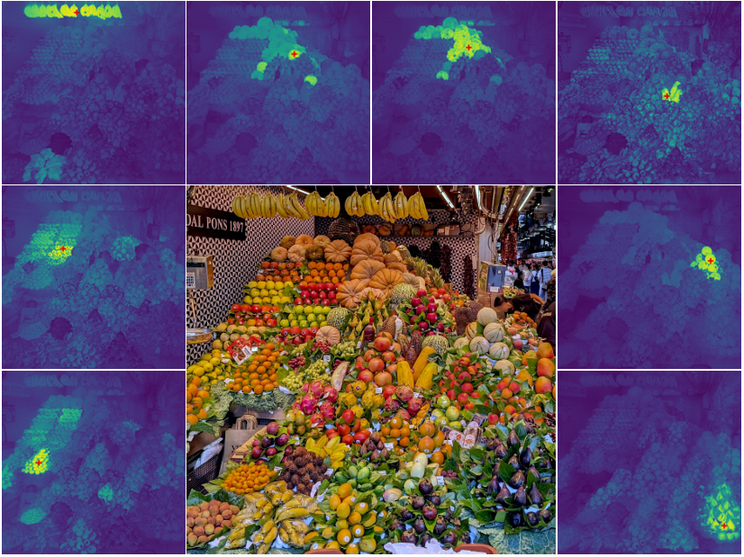

DINOv3
Phan Hải Minh
Thái Minh Khoa
Đặng Vĩnh Tường
Lecturer:
Bùi Duy Đăng
Huỳnh Lâm Hải Đăng
Trần Trung Kiên

Slide 2
Table of contents
01
02
03
Problem Statement
DINOv3 Overview
Gram anchoring
04
05
Application
Conclusion
01

Slide 3

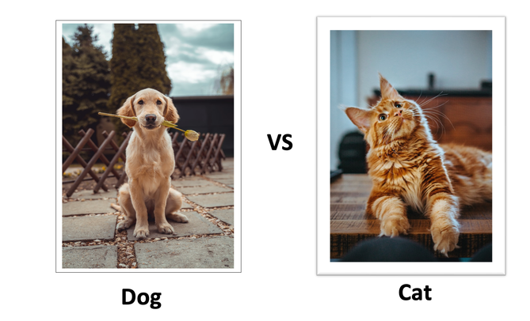
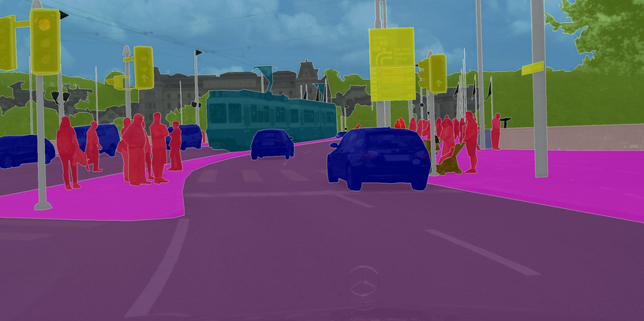
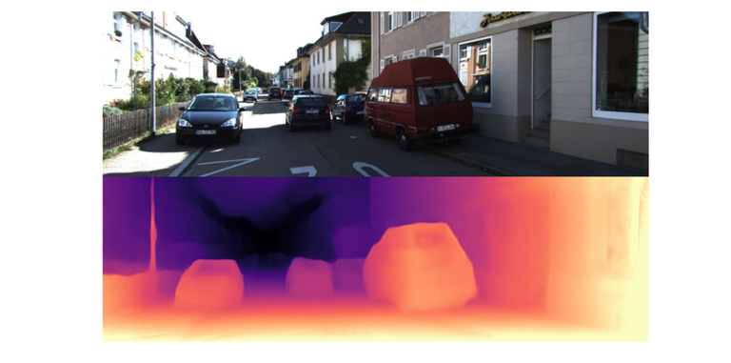
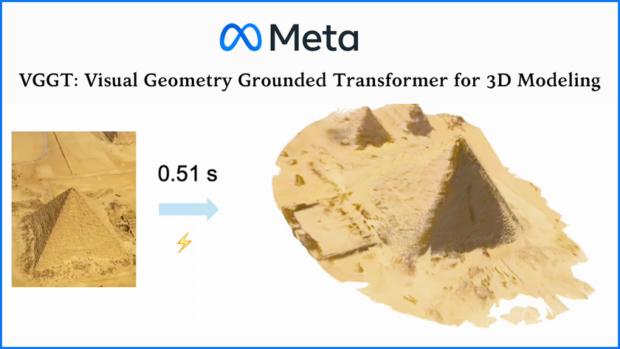

01. Problem Statement
Some computer Vision Tasks:
Object detection
Image classification
Image Segmentation
Monocular Depth Estimation
Visual Geometry Grounded Transformer
03

Slide 4
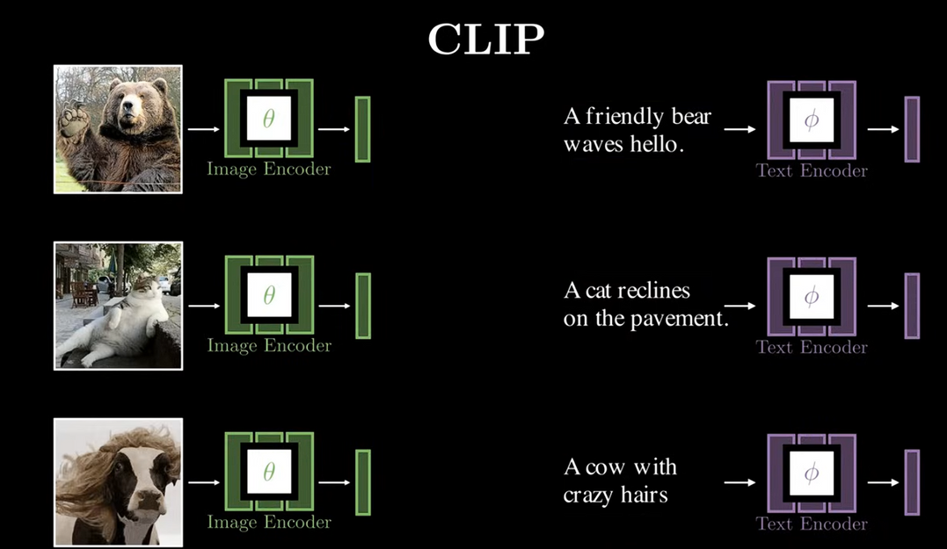
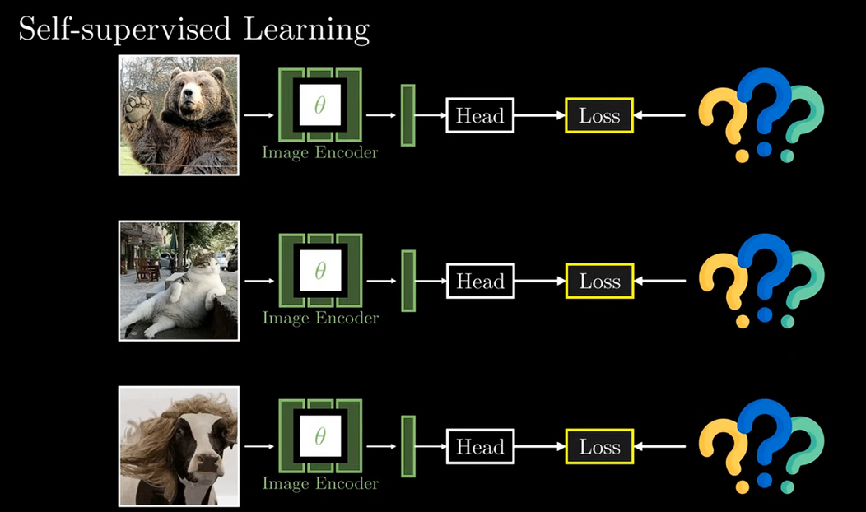
How can we train without caption of image ?
Img src: How AI Taught Itself to See [DINOv3]
03

Slide 5
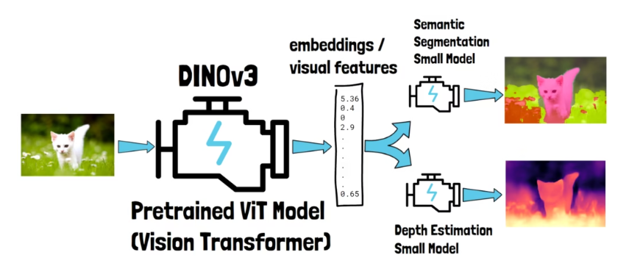
02. DINOv3 overview
Img src: DINOv3 Paper Explained: The Computer Vision Foundation Model
04

Slide 6
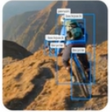
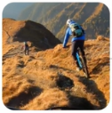



Classification
DINOv3 pipeline
Biking
Detection
DINOv3 Features
Segmentation
Image input
DINOv3 Frozen Backbone
Deep
...
Output
Head
04

Slide 7




DINOv3 architecture
CLS
Teacher Vision Transformer
CLS
Head
DINO Loss + iBOT Loss
(Update via EMA and gram anchoring)
Distillation Loss
Unlabeled images
Multi-view Data Augmentation
(Global Crops + Local Crops)
CLS
Student Vision Transformer
CLS
Head
Update student
04

Slide 8
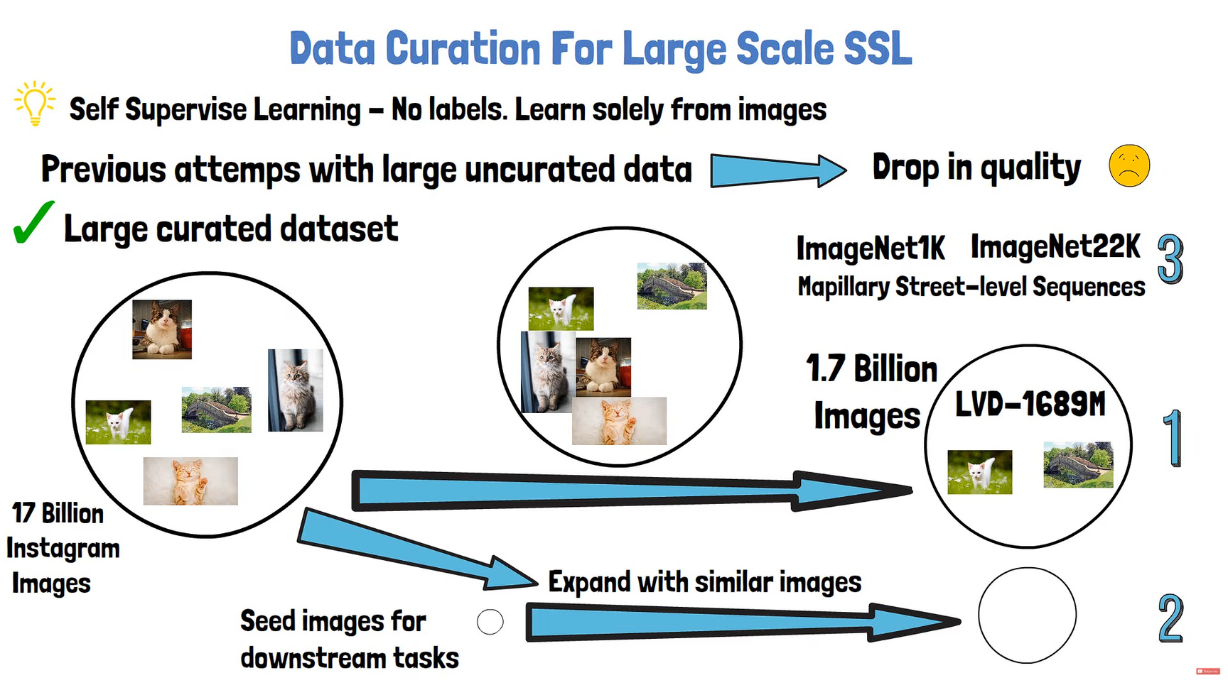
Data curation
Img src: DINOv3 Paper Explained: The Computer Vision Foundation Model
04

Slide 9

Self-supervised learning
Global crop
Teacher Vision Transformer
CLS
CLS
0.06
.....
0.02
DINO head
Similar
Student Vision Transformer
0.05
CLS
CLS
Global crop or
Local crop
.....
0.01
04

Slide 10

Self-supervised learning
Global crop
Teacher Vision Transformer
CLS
Similar
CLS
Student Vision Transformer
Global crop or
Local crop
iBOT head
04

Slide 11
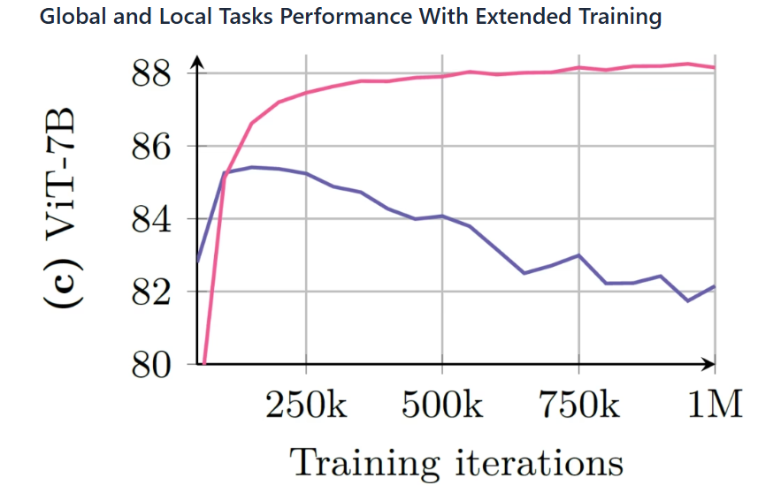
03. Gram Anchoring
DINOv2 Scaling issues:
Img src: DINOv3 Paper Explained: The Computer Vision Foundation Model
05

Slide 12
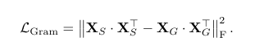
X . X
T
G G
Global crop
Teacher Gram Matix
Gram Teacher
Similar
Student Gram Matix
CLS
Student Vision Transformer
Global crop
X . X
T
S S
04

Slide 13
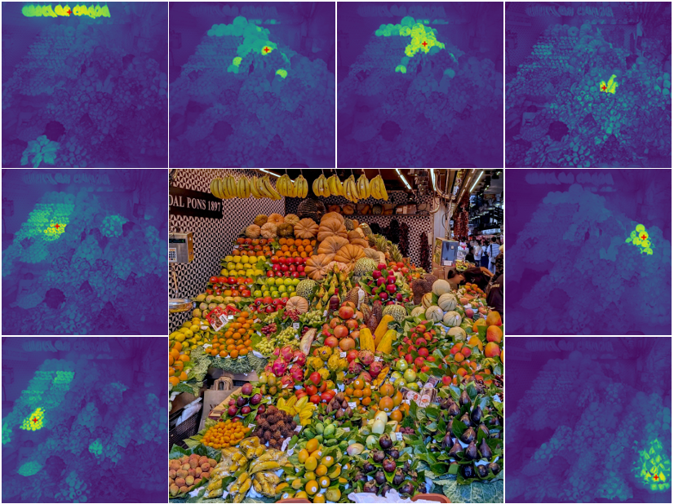
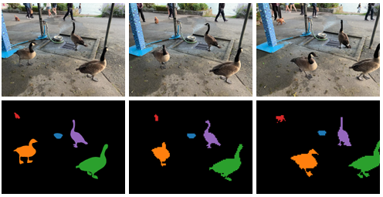
04.Application
Object Detection
Image Classification - Linear Probing
Semantic Segmentation
Unsupervised Object Discovery
Video Segmentation Tracking
Video Classification
...
06

Slide 14
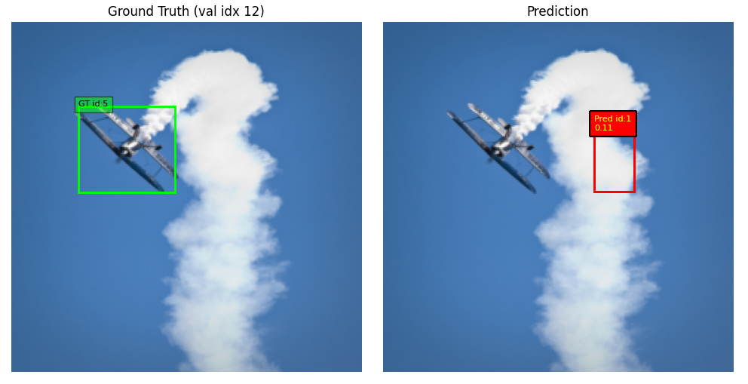
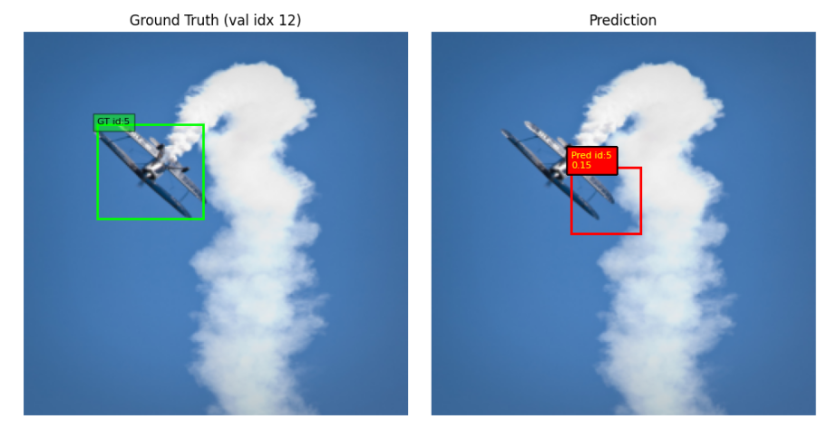
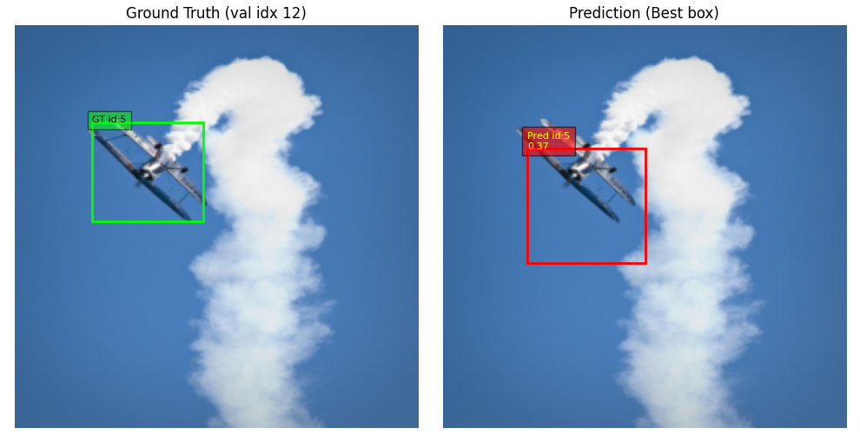
Object detection
Backbone: facebook/dinov3-vits16-pretrain-lvd1689m
Head: DETR self trained
Dataset: COCO 2017 with 2400 images
Epoch = 5
Epoch = 15
Epoch = 50
07

Slide 15
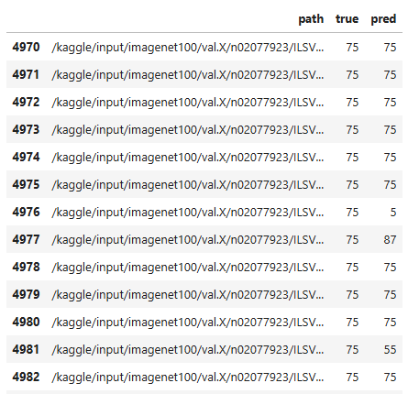
Image classification
Backbone: facebook/dinov3-vits16-pretrain-lvd1689m
Head: Multinomial Logistic Regression
Dataset: imagenet100 with 130000 images
08

Slide 16
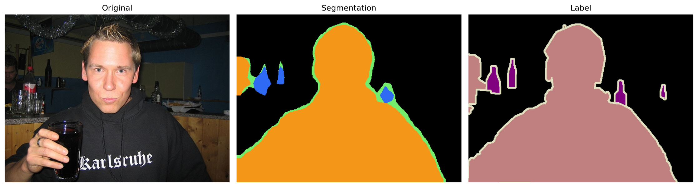
Semantic Segmentation
Backbone:
dinov3-vitb16-pretrain-lvd1689m
dinov3-vits16-pretrain-lvd1689m
Dataset: VOC 2012 Segmentation Data (1464 images)
09

Slide 17
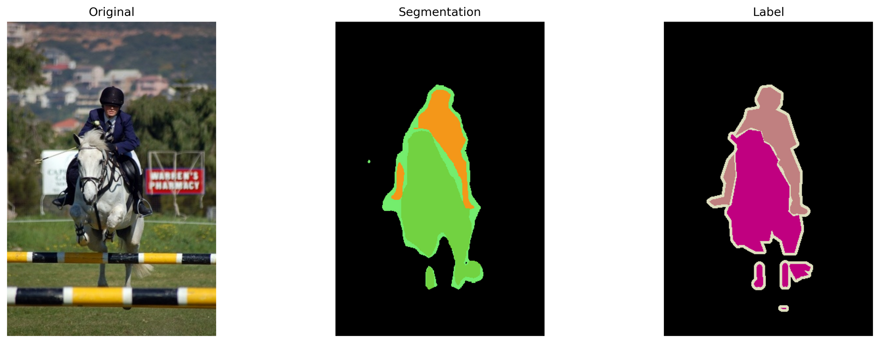
Semantic Segmentation
Performance is measured using mIoU (mean intersection of union)
dinov3-vitb16-pretrain-lvd1689m ~ 0.660
dinov3-vits16-pretrain-lvd1689m ~ 0.606
09

Slide 18
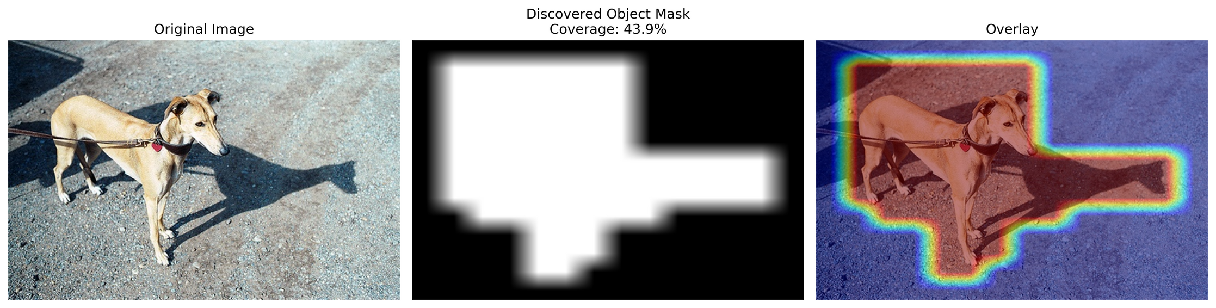
Unsupervised Object Discovery
DINOv3 ViT-S/16 backbone with TokenCut for unsupervised object discovery on Pascal VOC 2007, evaluated using CorLoc and mean IoU
10

Slide 19
05. Conclusion
DINOv3 is a powerful self-supervised vision foundation model that learns rich and transferable visual representations without labeled data.
The model demonstrates strong generalization and flexibility across different computer vision applications.
These findings highlight the potential of DINOv3 as a general-purpose backbone for modern vision systems.
13

Slide 20

Thank you for listening!
Do you have any questions?
ask_me@clc.fitus.edu.vn
14

